Slide 1
MIMIC Visualization
ba27444
Code - https://colab.research.google.com/drive/15TFIIfmeQBp6pbhDO5NS4AWWH9asNLPy?usp=sharing

Slide 2
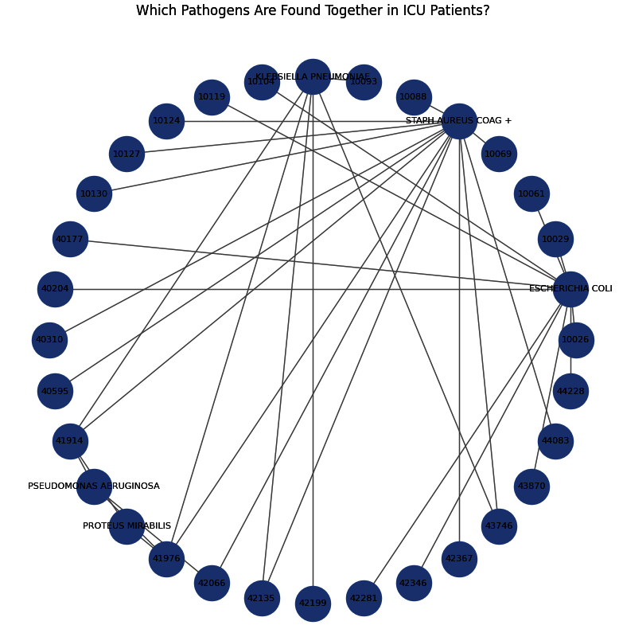
How are different microbiology test results connected?
Motivation: A hospital performs thousands of procedures every day, but which ones are the most prescribed?
Steps:
Upload MICROBIOLOGYEVENTS tables
Select top microbio organism name
Plot Chord
Observation: Chord Diagram reveals patterns in bacterial co-occurrence, which can help doctors decide on appropriate antibiotic treatments and improve infection control policies. E.Coli and Pneumonia are commonly found pathogens.

Slide 3
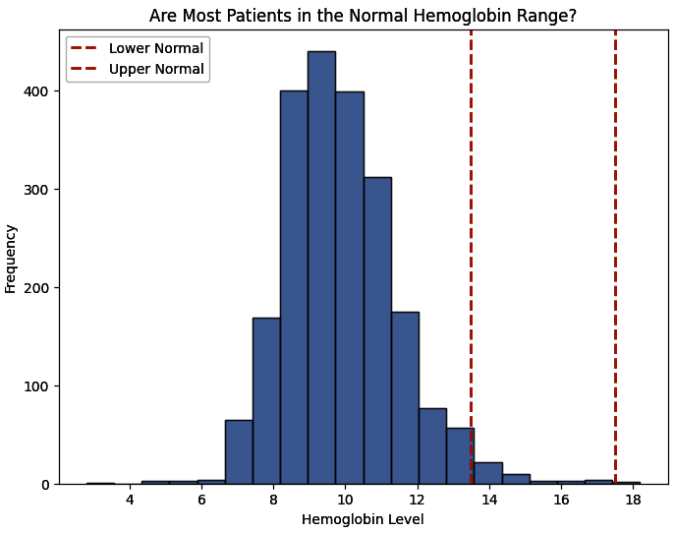
Do most patients have normal Hemoglobin levels?
Motivation: A hospital performs thousands of procedures every day, but which ones are the most common?
Steps:
Upload LABEVENTS and D_LABITEMS tables
Merge the two tables on item ID
Select values for “Heamoglobin”
Plot Histogram
Observation: Most patients do not have heamoglobin in normal range. by comparing the distribution against normal levels (13.5–17.5 g/dL for adults), we can detect anemia or polycythemia trends in ICU patients

Slide 4

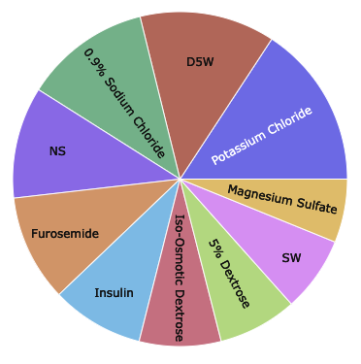
Which medications are prescribed the most
Motivation: A hospital performs thousands of procedures every day, but which ones are the most prescribed?
Steps:
Upload PRESCRIPTIONS tables
Select top 10 drugs
Plot Sunburst chart (interactive chart)
Observation: Observe the drugs are commonly used is Potassium Chloride, Insulin, etc. , this can help with formulary management and reducing medication errors.

Slide 5
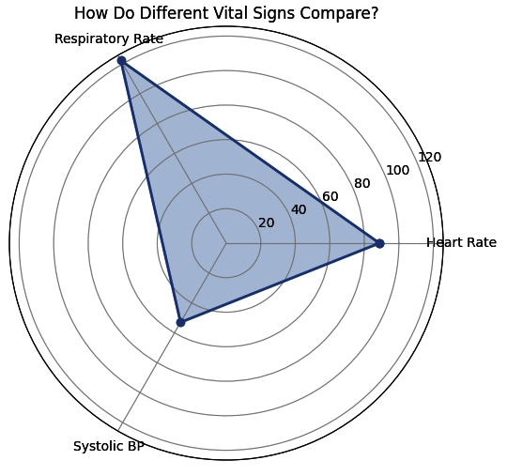
How do different vital signs compare?
Motivation: A hospital performs thousands of procedures every day, but which ones are the most prescribed?
Steps:
Upload CHARTEVENTS tables
Select vital signs - Heart Rate, BP
Plot Radial Chart
Observation: Radial Chart may help ICU staff quickly compare different vital signs to identify abnormal trends, making it easier to spot warning signs early.

Slide 6
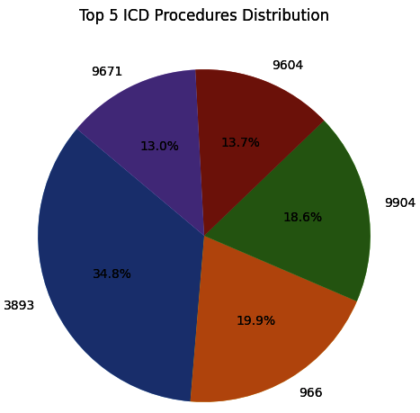
Which medications are prescribed the most
Motivation: A hospital performs thousands of procedures every day, but which ones are the most common?
Steps:
Upload PROCEDURES_ICD table
Select values for ICD9 codes count
Plot Pie Chart
Observation: One third of procedures are for 3893. Thus hospitals can allocate resources efficiently, ensuring staff and equipment accordingly.

